Slide 1
CART Algorithm

Slide 2
What is CART?
CART stands for Classification And Regression Trees.
- Supervised learning algorithm
- Used for classification and regression
- Produces binary decision trees

Slide 3
Key Characteristics of CART
- Binary splits only
- Uses Gini Index (classification)
- Uses Mean Squared Error (regression)
- Works with numerical and categorical features
- Supports pruning

Slide 4
Gini Index (Classification)
Gini = 1 − Σ (pi)^2
Where pi is the probability of class i in a node.
Lower Gini → purer node.
CART chooses split with minimum weighted Gini.

Slide 5
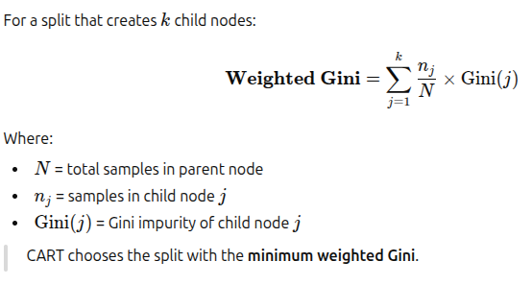
Weighted Gini in CART?
In CART (Classification and Regression Trees), when a node is split into child nodes, do not look at each child’s Gini separately.
Compute a weighted average of the Gini impurities of the child nodes.

Slide 6
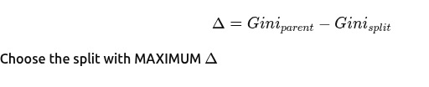
To choose the split
1. Subtract from parent (Impurity Reduction)
2. Weighted child impurity
Choose the split with MINIMUM weighted Gini

Slide 7
Steps in CART Algorithm
1. Select best feature and threshold using Gini/MSE
2. Split data into two child nodes
3. Repeat recursively for each node
4. Stop when stopping criteria is met
5. Optionally prune the tree

Slide 8
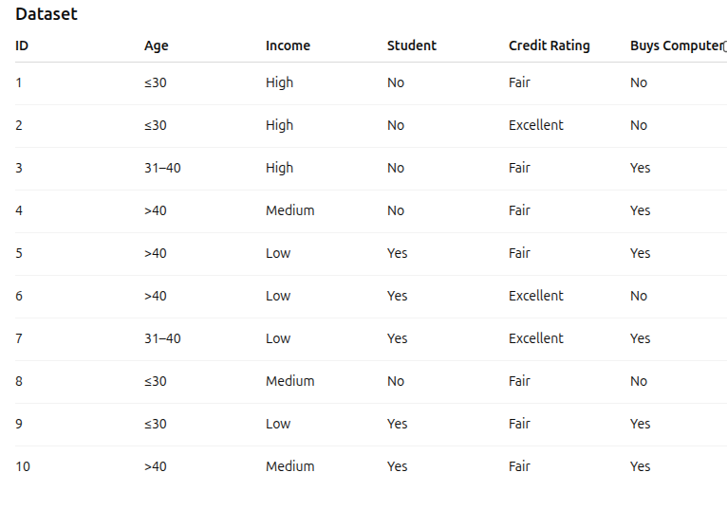

Slide 9
Step 1: Root Node Gini
Yes = 6, No = 4
Gini = 1 − (6/10)² − (4/10)²
Gini(root) = 0.48

Slide 10
Possible CART binary splits for Age
1️ {≤30} vs {31–40, >40}
2️. {31–40} vs {≤30, >40}
3️. {>40} vs {≤30, 31–40}

Slide 11
Split 1: {≤30} vs {31–40, >40}
Group 1 (≤30)
Yes = 1, No = 3
Gini1=1−(1/4)2−(3/4)2=0.375
Group 2 (31–40, >40)
Yes = 5, No = 1
Gini2=1−(5/6)2−(1/6)2=0.278

Slide 12
Weighted Gini
=(4/10)(0.375)+(6/10)(0.278)
=0.15+0.1668=0.3168

Slide 13
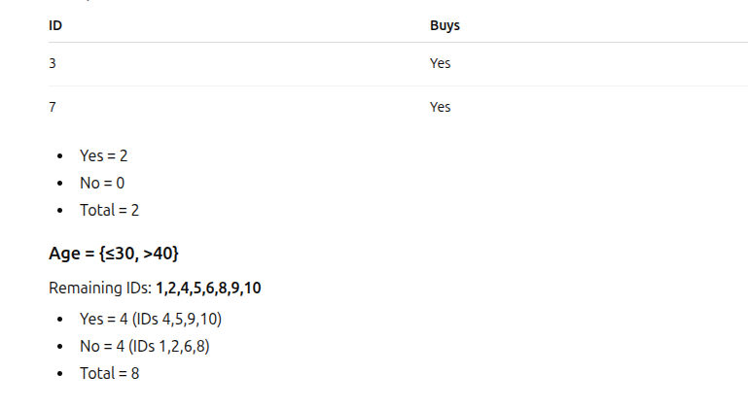
{31–40} vs {≤30, >40}

Slide 14
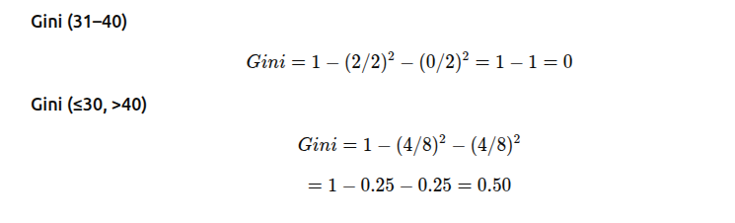
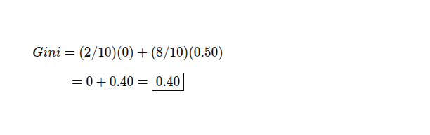

Slide 15
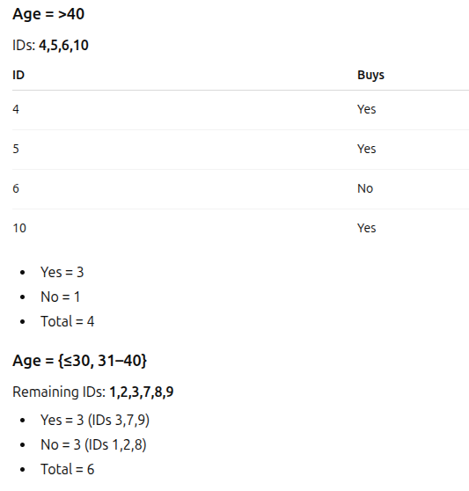
{>40} vs {≤30, 31–40}

Slide 16
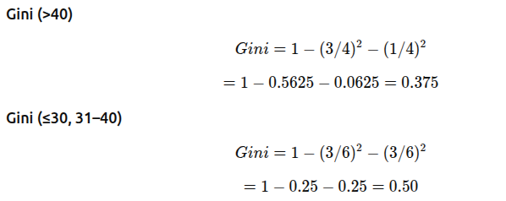
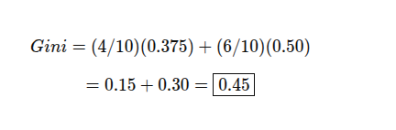

Slide 17
{≤30} vs {31–40, >40} → Gini = 0.3168 -selected
{31–40} vs {≤30, >40} → Gini = 0.40
{>40} vs {≤30, 31–40} → Gini = 0.45

Slide 18
INCOME (Binary Options)
{Low} vs {High, Medium} → Gini = 0.45
{High} vs {Medium, Low} → Gini = 0.419
{Medium} vs {High, Low} → Gini = 0.476

Slide 19
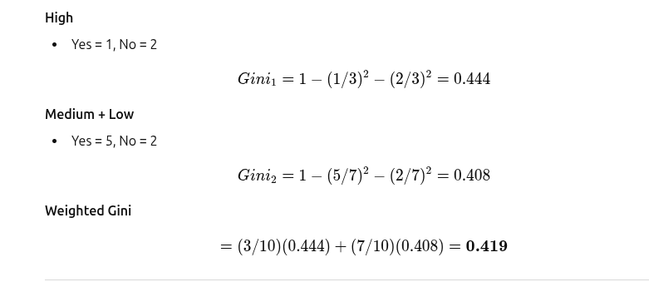

Slide 20
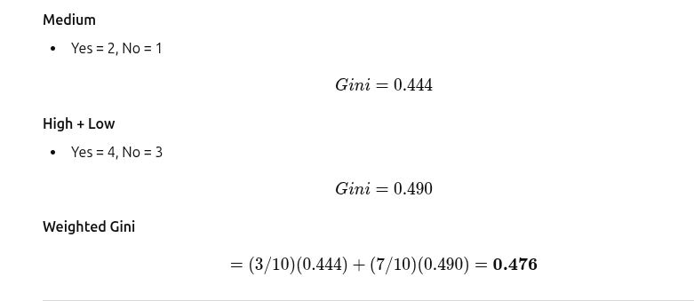

Slide 21
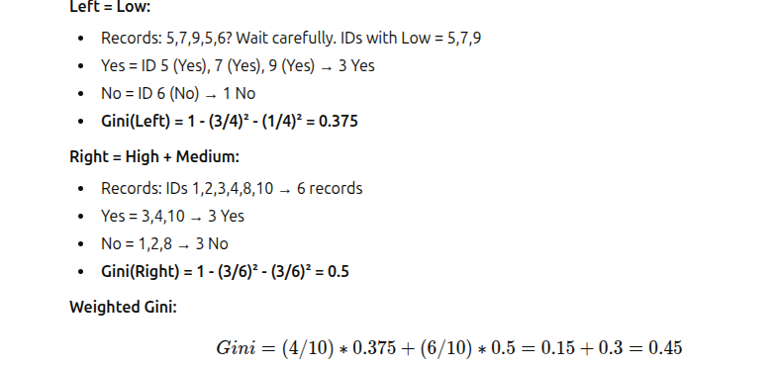

Slide 22
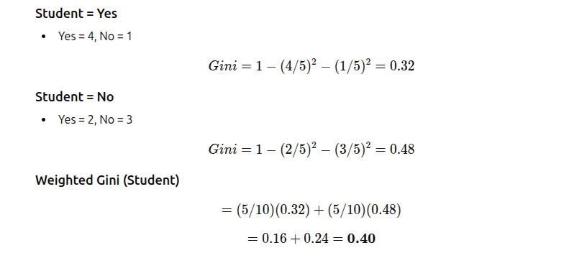
Student

Slide 23
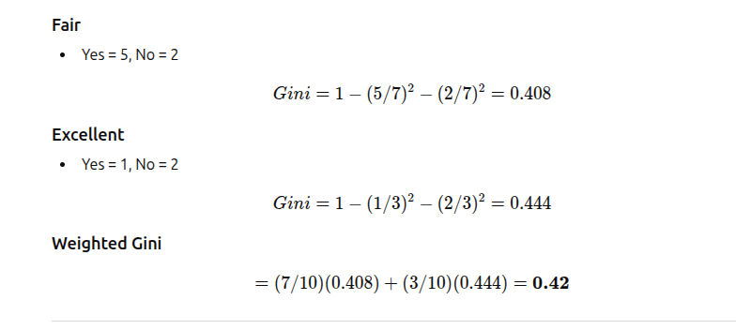
Credit rating

Slide 24
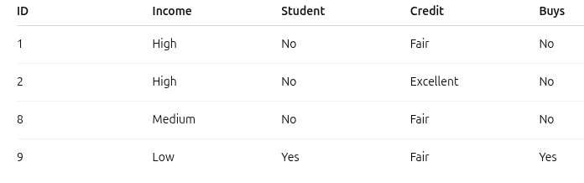
AGE - root Left Subtree: Age ≤ 30

Slide 25
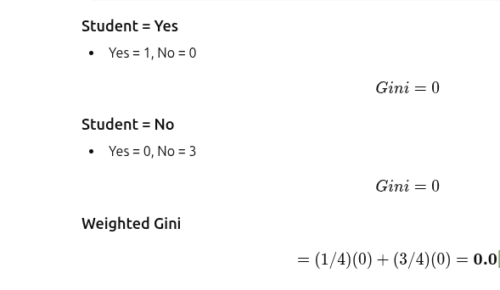
Student

Slide 26
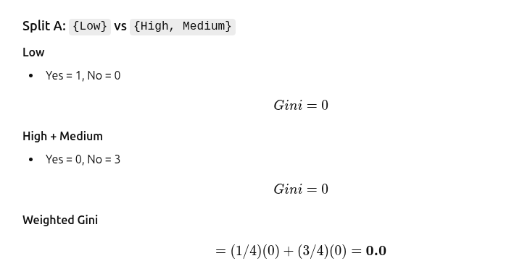
Income

Slide 27
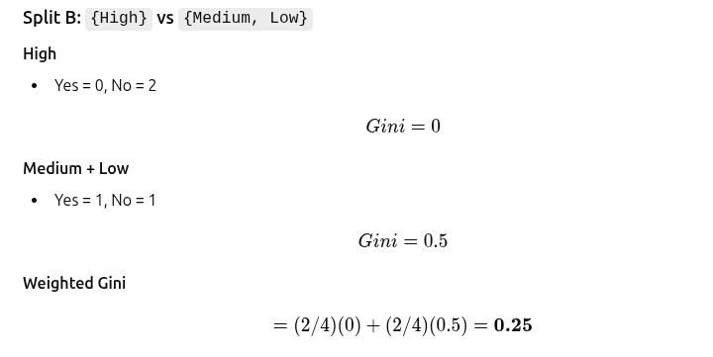

Slide 28
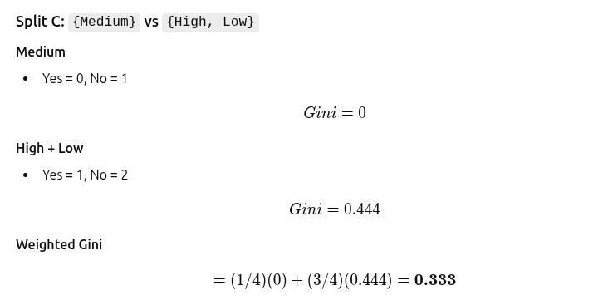

Slide 29
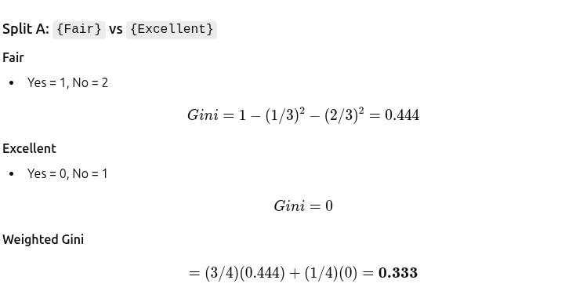
Credit rating

Slide 30
Best split- Student
Student = Yes → Yes = 1, No = 0 → Pure
Student = No → Yes = 0, No = 3 → Pure
Age ≤ 30
|
Student?
/ \
Yes No
(Yes) (No)

Slide 31
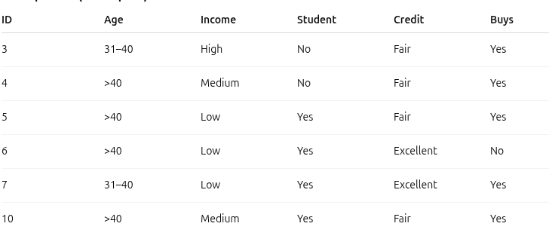
Right Subtree: Age > 30

Slide 32
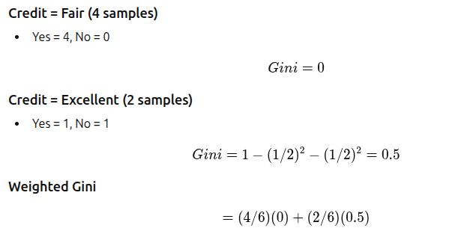
Credit rating
=0.167

Slide 33
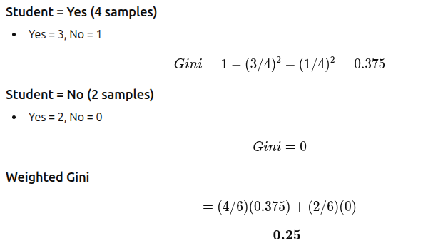
student

Slide 34
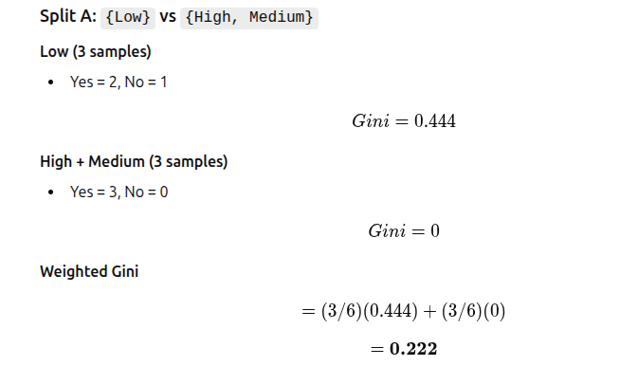
Income

Slide 35
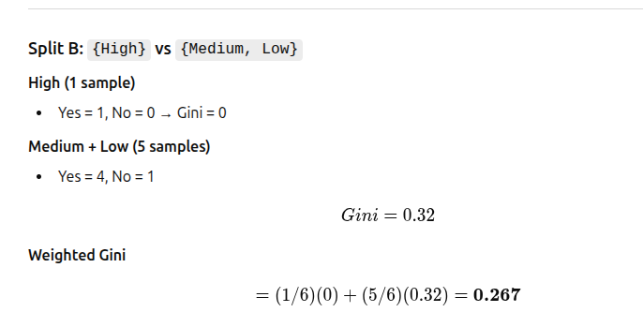

Slide 36
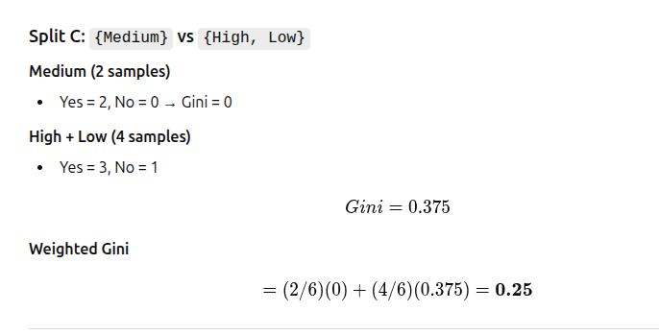

Slide 37
Age Split: {31–40} vs {>40}
31–40 → IDs 3,7 → Yes=2, No=0 → Gini = 0
>40 → IDs 4,5,6,10 → Yes=3, No=1 → Gini = 0.375
Weighted Gini:
(2/6)(0)+(4/6)(0.375)=0.25(2/6)(0) + (4/6)(0.375) = 0.25(2/6)(0)+(4/6)(0.375)=0.25

Slide 38
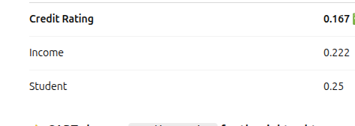
Choose the best – credit rating is the best
Age - 0.25

Slide 39
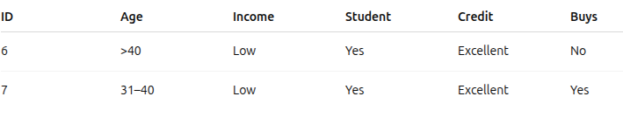
Right Subtree: Credit = Excellent

Slide 40
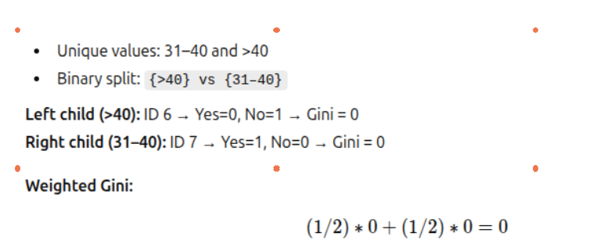
Right Subtree: Credit = Excellent
For Age
Leaves are pure

Slide 41
Student
Left child (Student = Yes): Yes = 1, No = 1
Right child (Student = No): 0 records
Weighted Gini:
(2/2)∗0.5+(0/2)∗0=0.5
Income
Left child (Income=low) : Yes = 1, No = 1
No right child
Weighted Gini:
(2/2)∗0.5+(0/2)∗0=0.5

Slide 42
Weighted Gini:
Student =0.5
Income=0.5
Age=0

Slide 43
Student and Income cannot split (no variability)
Split Age → produces pure leaves

Slide 44
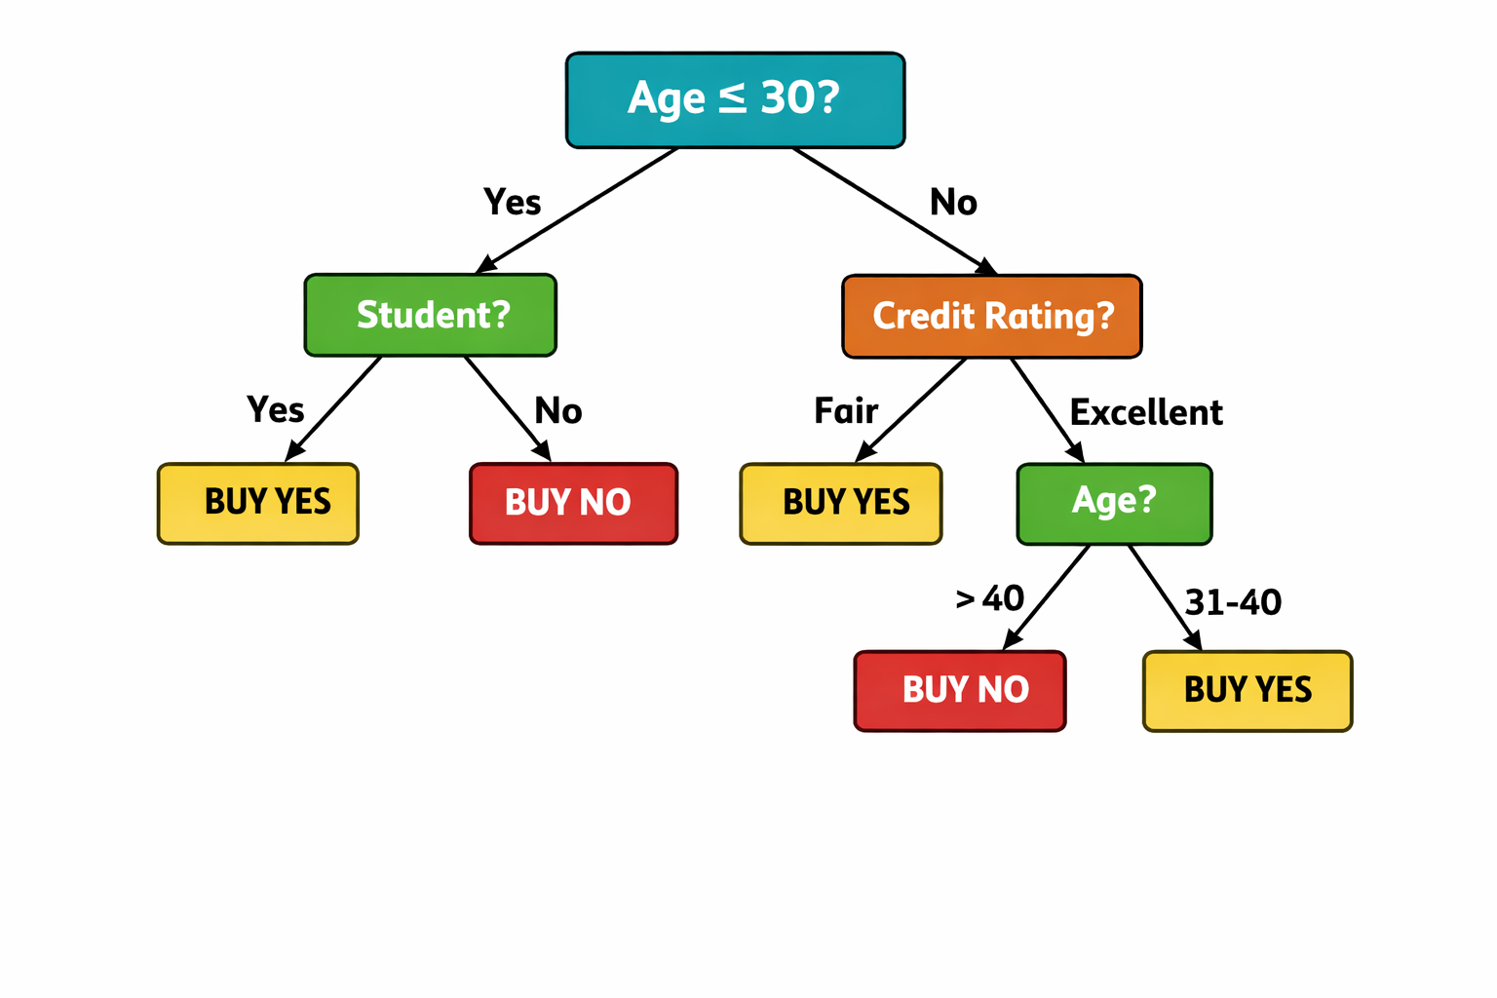
Final Tree

Slide 45
Other possibilities (Leaf decision)
For example(if Age attribute is not available, and when student and Income has same value, no reduction in impurity)
Tie → take parent majority
Parent, majority = Yes
Predict YES

Slide 46
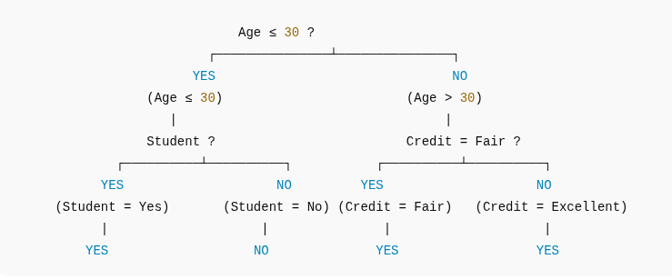
Final Tree(For Tie)

Slide 47
Every split is strictly binary
All attributes tested at every node
Root Gini is baseline impurity
CART stops at pure nodes

Slide 48
Pruning in CART
Pruning is used to prevent overfitting by trimming branches of the decision tree that add little or no improvement to model accuracy. It simplifies the tree, improves generalization and reduces model complexity.
Types of Pruning in CART
Cost Complexity Pruning: Removes branches by comparing the trade off between tree accuracy and tree size, keeping only those nodes that significantly improve performance.
Reduced Error Pruning: Eliminates nodes that do not improve the model’s accuracy on a validation dataset, ensuring only beneficial splits remain.

Slide 49
Common Stopping or Pruning Criteria Used in CART
Maximum tree depth reached: The tree stops growing after a predefined maximum depth.
Minimum samples required to split a node: Splitting stops when a node has fewer samples than the minimum required.
No further improvement in impurity: If a split does not reduce impurity or error, CART stops splitting.
Node becomes pure: When all samples belong to one class, no further split is needed.

